Slide 1
Smart Shopping

Slide 2
Objective
Developing the most interactive app by bringing augmented reality into the picture. This would reduce the efforts of a customer during his search for an ingredient/product for preparing a new dish or a dish for which the customer don’t have enough awareness, in any shopping mart.
Motivation
To provide an ease in the shopping process for the customers who are looking for a completely new ingredient/product as a part of preparation of a new dish/dish they are not aware of in huge supermarkets.

Slide 3
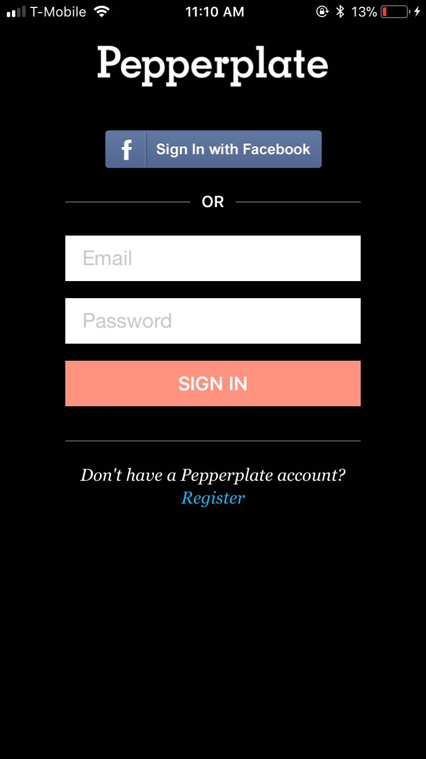
Sample design of the app:
Sign In/Register cover:

Slide 4
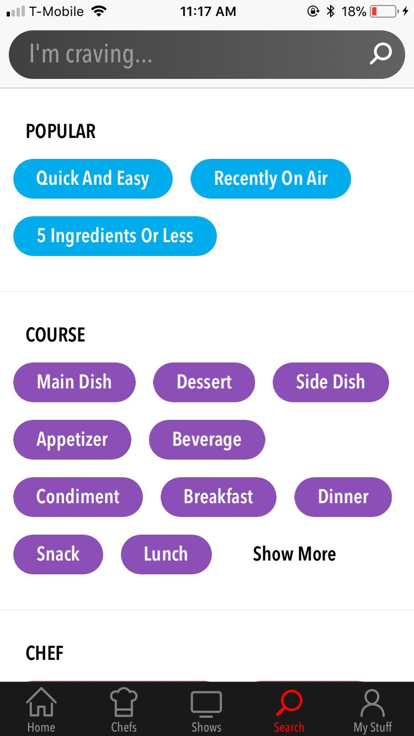
Display of different courses:

Slide 5
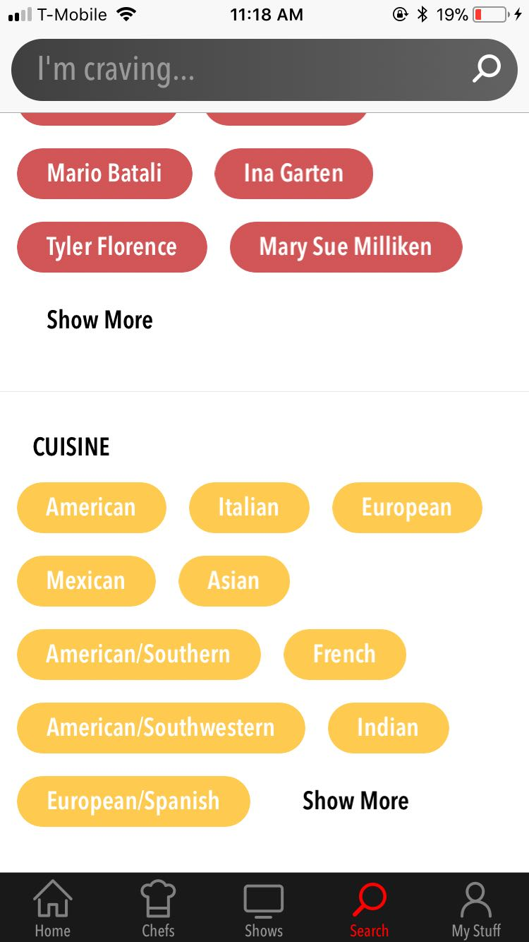
Display of different cuisines:

Slide 6
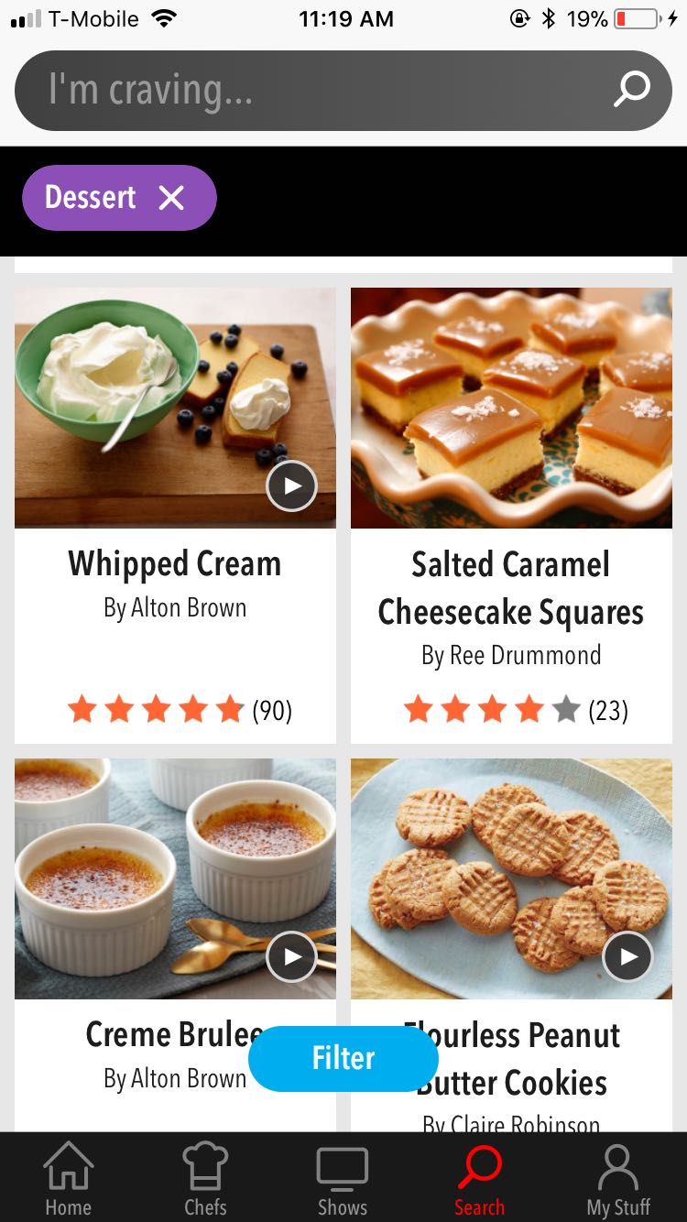
Upon selection of dessert under course category:

Slide 7
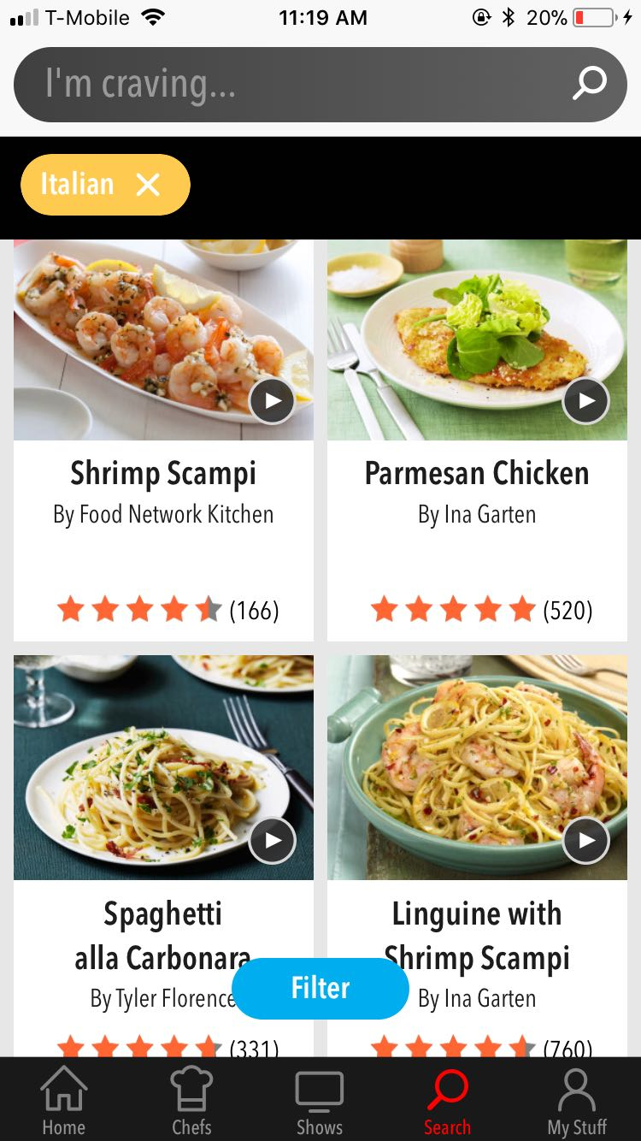
Upon selection of Italian under cuisine category:

Slide 8
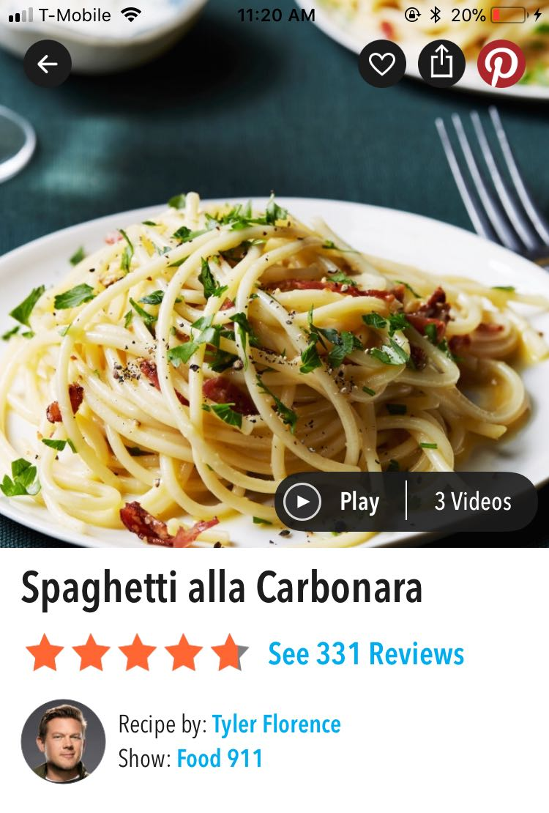
Selecting Spaghetti alla Carbonara dish for recipe:

Slide 9
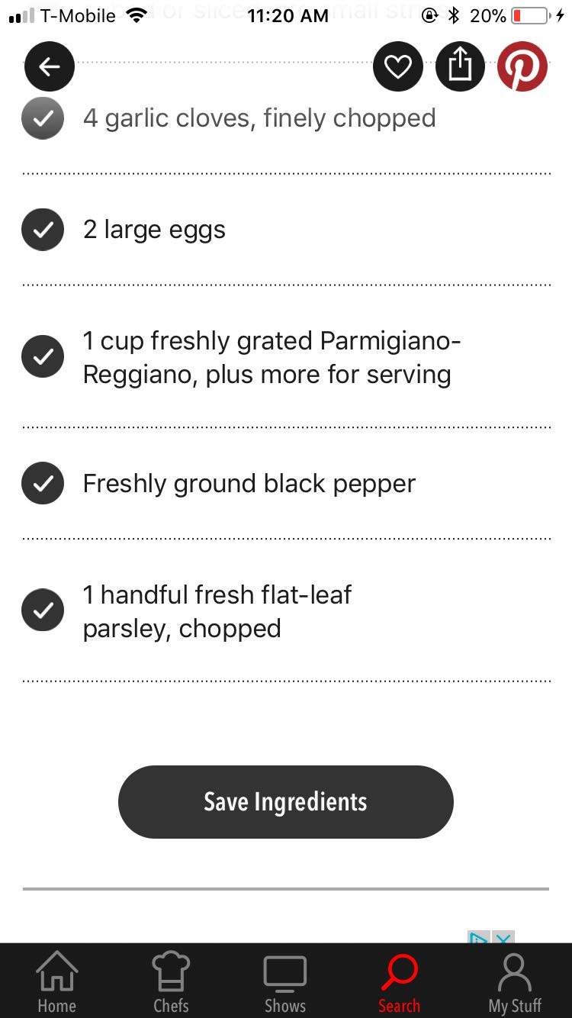
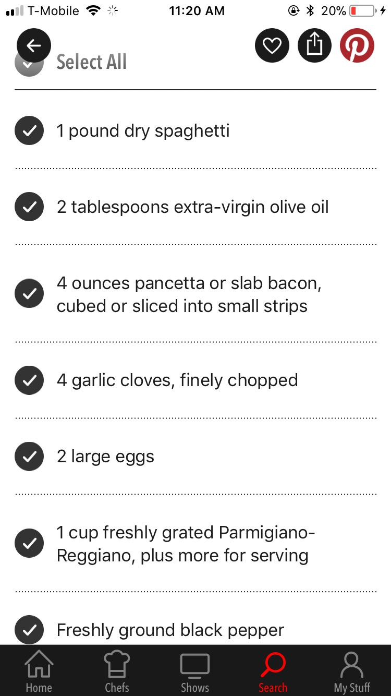
Display of the recipe for the selected dish:

Slide 10
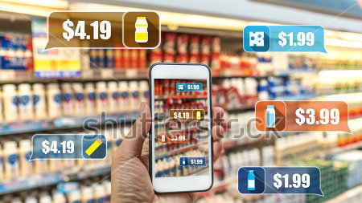
User can be able to get the pop ups of the items displayed in the recipe list along with the required details when user walks through any shopping mart.

Slide 11
Thankyou

